Slide 1
Logic Analyzer

Slide 2
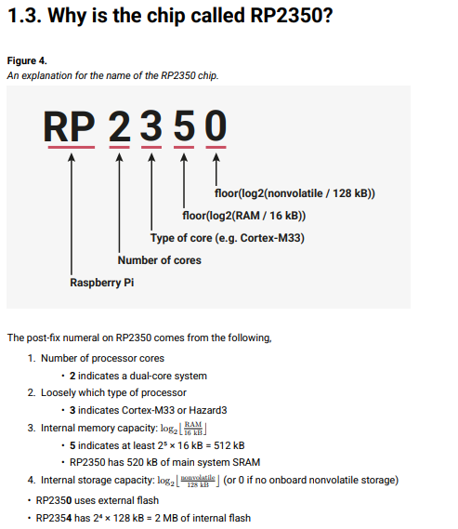
Rp2350 Pico pi | rp2454b
https://shopee.vn/Raspberry-Pi-Pico2-Ban-Ph%C3%A1t-Tri%E1%BB%83n-RP2350-4MB-Vi-%C4%90i%E1%BB%81u-Khi%E1%BB%83n-RaspberryPi-Pico2-RP2040Typec-i.793766351.51659363099?extraParams=%7B%22display_model_id%22%3A320828078355%2C%22model_selection_logic%22%3A3%7D

Slide 3
STM32F411 Blackpill
Mục tiêu: 8 Kênh, 1Mhz
1Mhz có thể lấy được
  Uart 9600, 115200 baudrate
  i2c: standard 100khz, fast 400khz
  Spi low speed

